Slide 1

Investigative journalism 101

Slide 2
1,485,416

Slide 3

M&T Bank Stadium could be filled 20 times with the reported COVID-19 cases in Maryland
M&T Bank Stadium could be filled 20 times with the reported COVID-19 cases in Maryland

Slide 4
Behind the Data: Understanding Covid Deaths in Maryland
By Group 3

Slide 5






Meet the Team
Henry
Saurabh
Athul
Srishti
Davya
David

Slide 6
The Story
01
02
03
Maryland & DMV
How does Maryland stand when compared to DMV area
Deep dive in Maryland
What does the covid trends look like in Maryland
Hypotheses
Bringing forward the core of the study
04
Closing notes
Impacts and opportunities

Slide 7

Maryland & Covid

Slide 8
Maryland & Covid
1.48M
18.8K
Reported Cases in Maryland
Associated Deaths, this includes probable and confirmed
92%
$480M
Vaccination: At least 1 dose
2020-2024
Relief Funds distributed through variety of organization

Slide 9
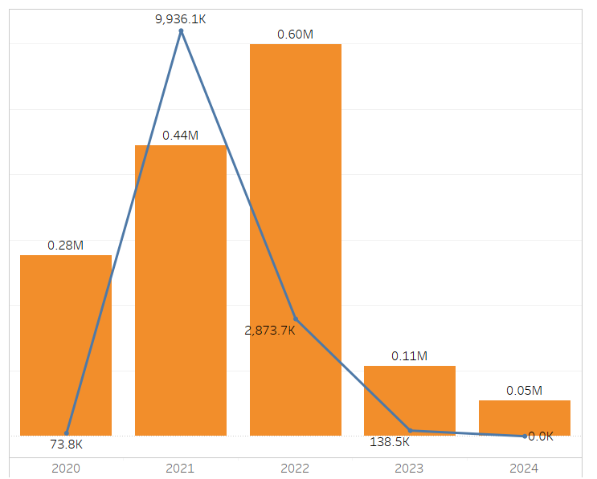
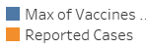
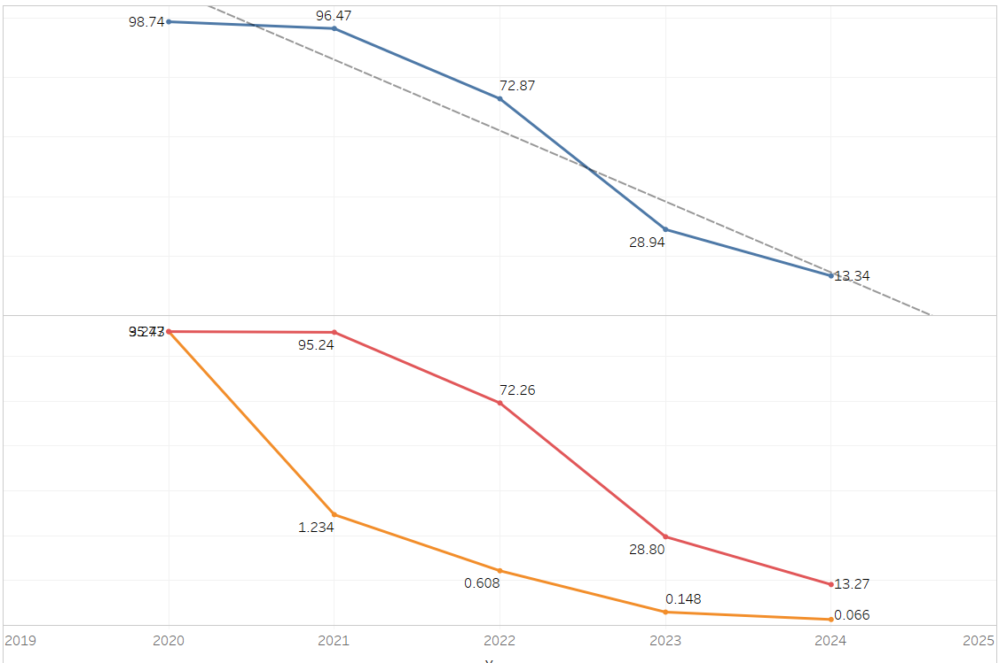

Trends
Covid Cases Peaked in 2022, controlled subsequently with vaccine administration
COVID-19 death rate fell 86% with better accuracy in identifying related deaths.

Slide 10

Deep dive in Maryland

Slide 11
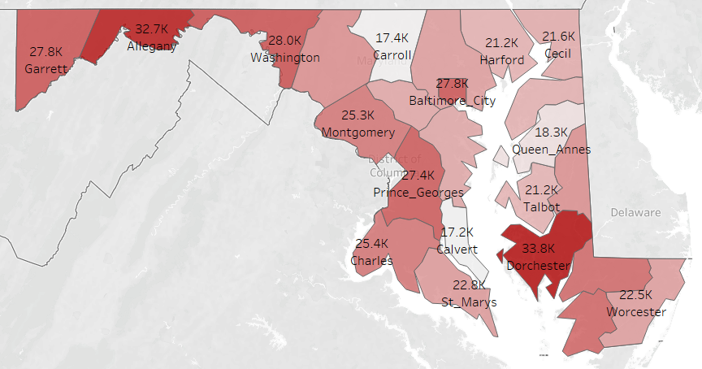
Covid cases per 100K
Demography & Reported Cases (per 100K)
Allegany & Dorchester has the highest covid reported Per 100K cases across the years.
Hispanic/Latina & African American race most affected by covid spread
Population split

Slide 12
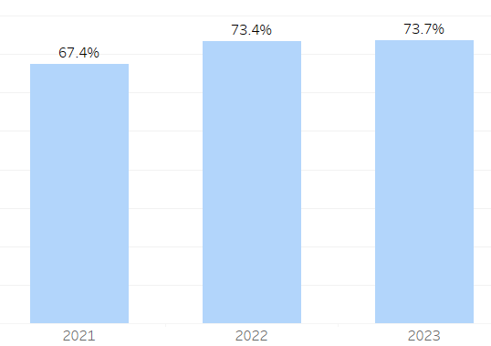
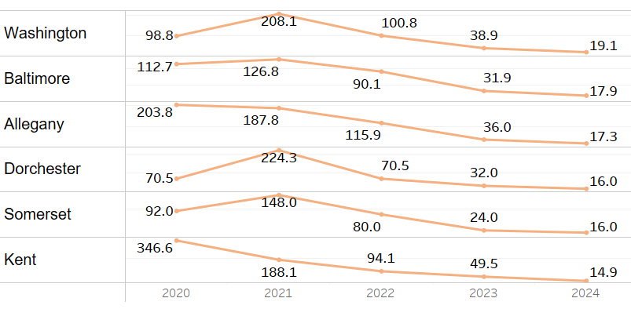
Fully Vaccinated
Death per 100K
By 2023, 74% of the people have been fully vaccinated
Death rate per 100K is still high in Washington county

Slide 13
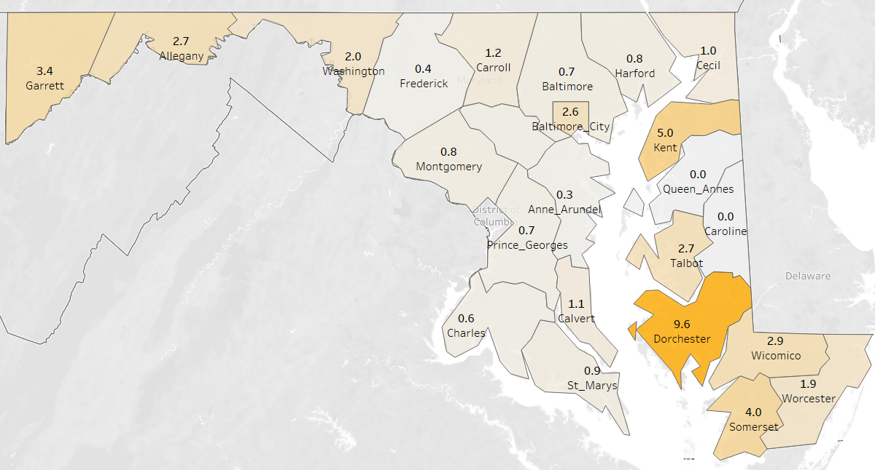
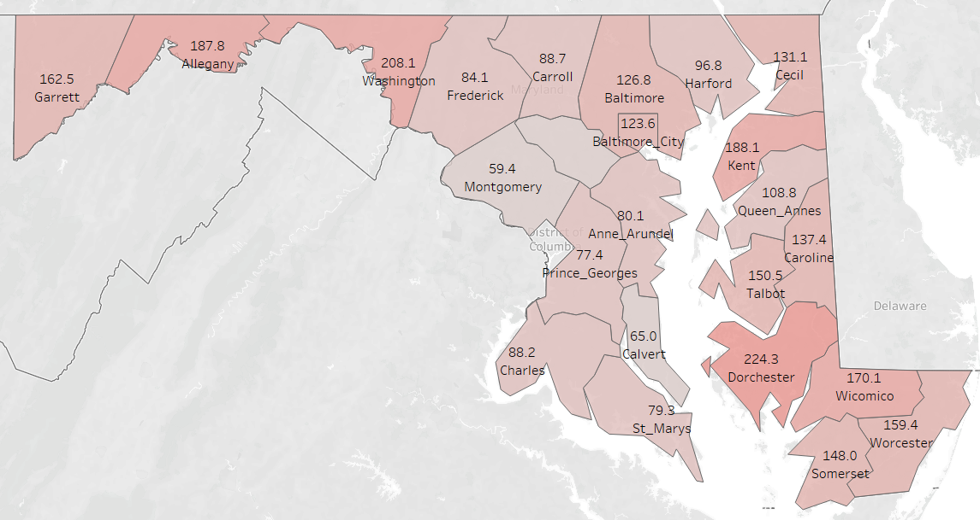
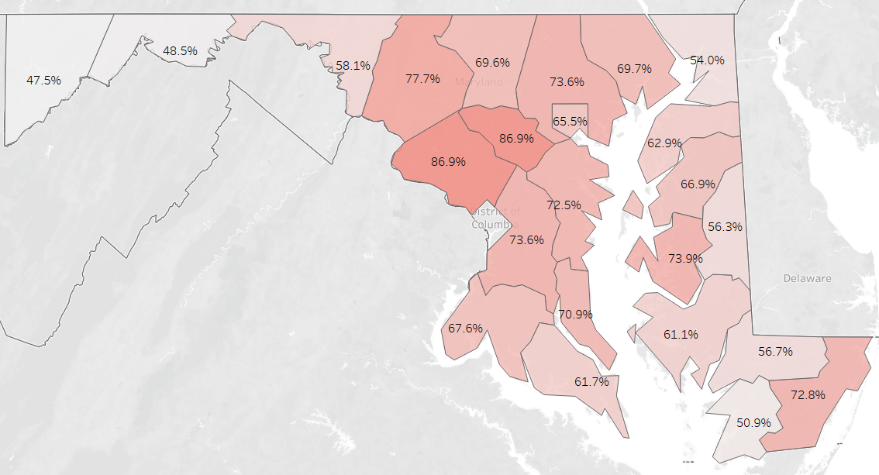
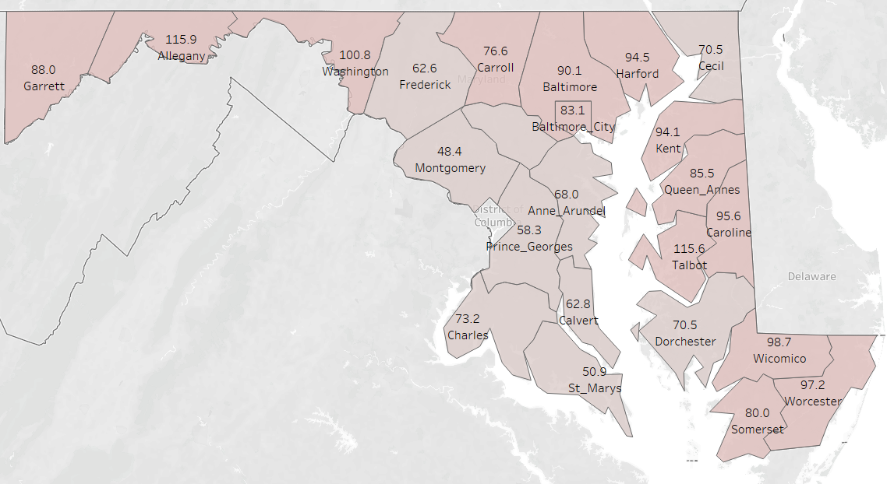
Hospital, Vaccines and death rates
Hospital per 100K
Death per 100K
Counties with good hospitals per 100K should have seen few mortality- remains relatively true, death rate in each state visualization needed
2022
Fully Vaccinated % by 2022
2023

Slide 14

Hypothesis 1

Slide 15
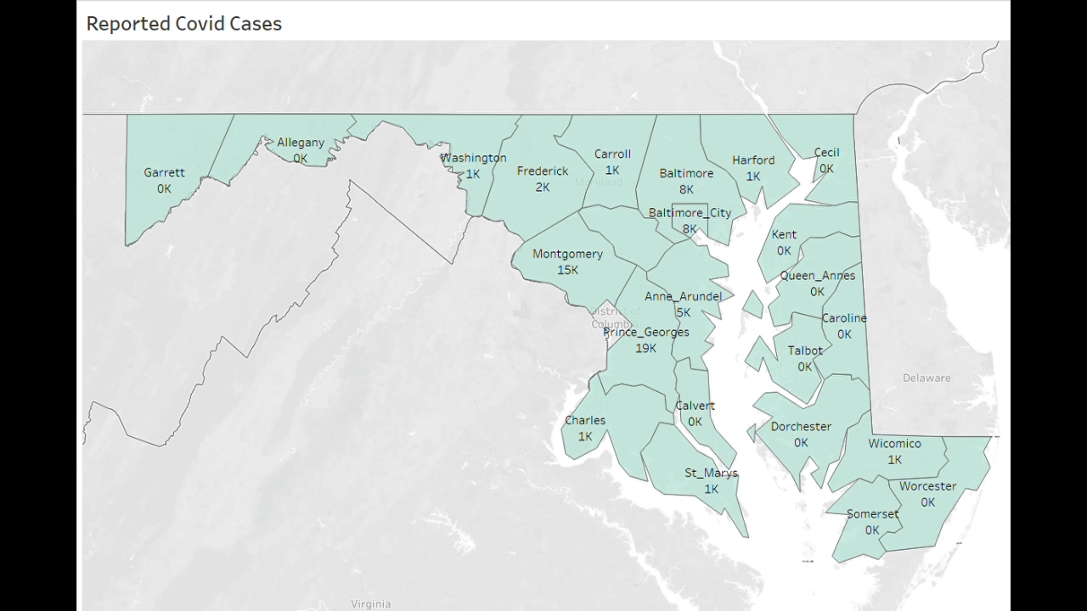
H1
Outbreak and spread of Covid from cities

Slide 16
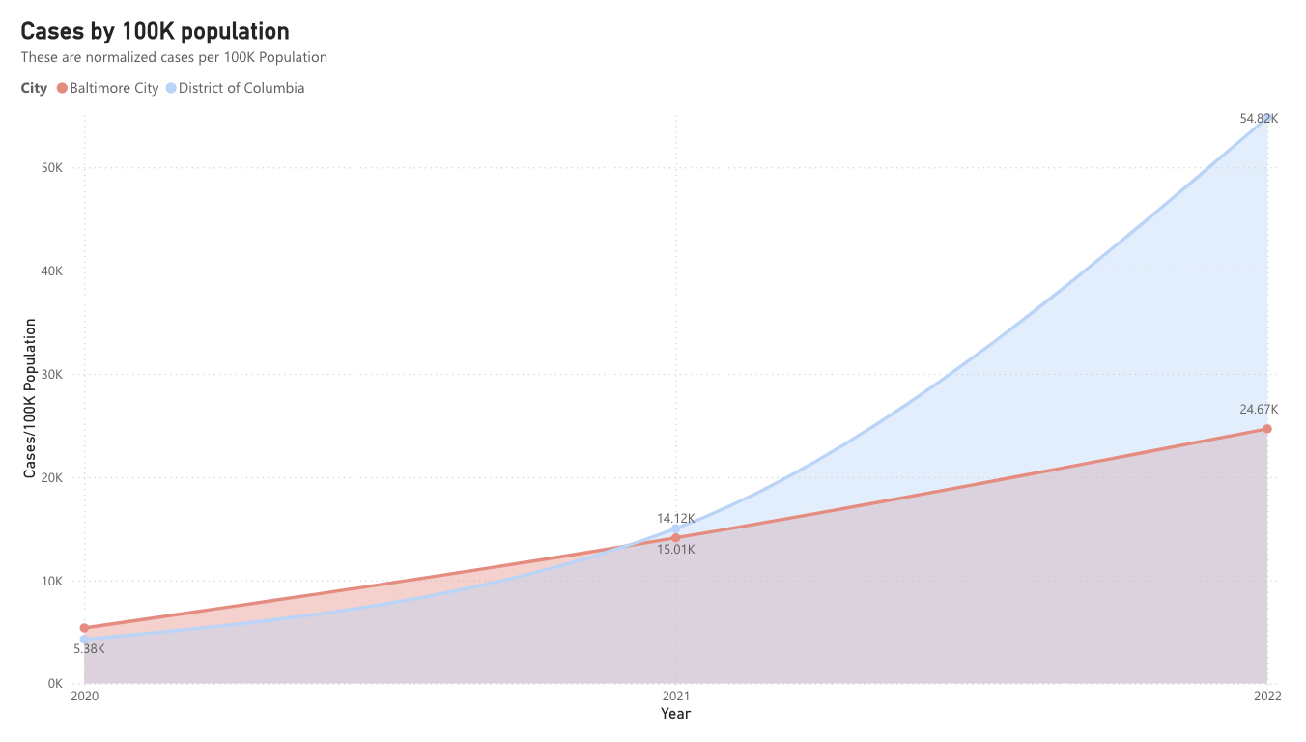
DC has seen a steep rise in confirmed cases in 2022.

Slide 17
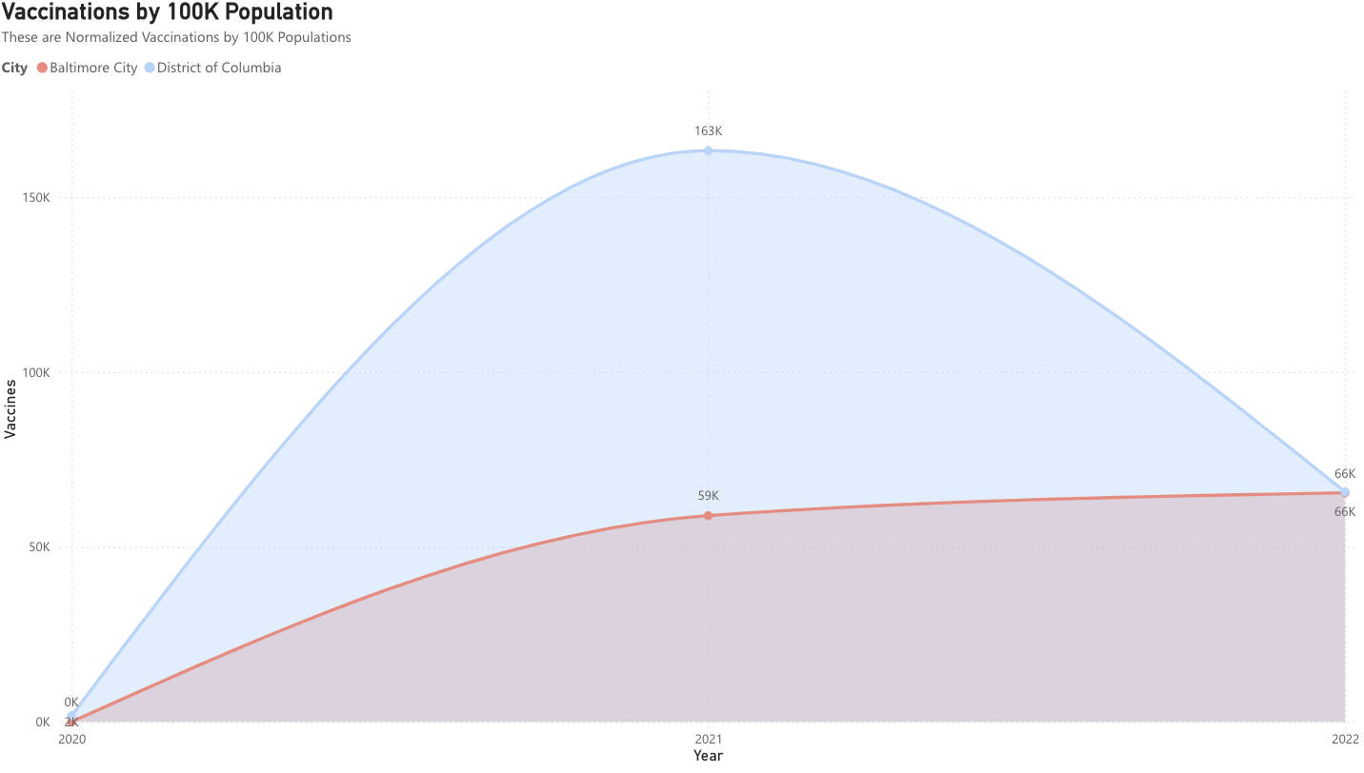
And, finally reason for the reversal of trend.

Slide 18
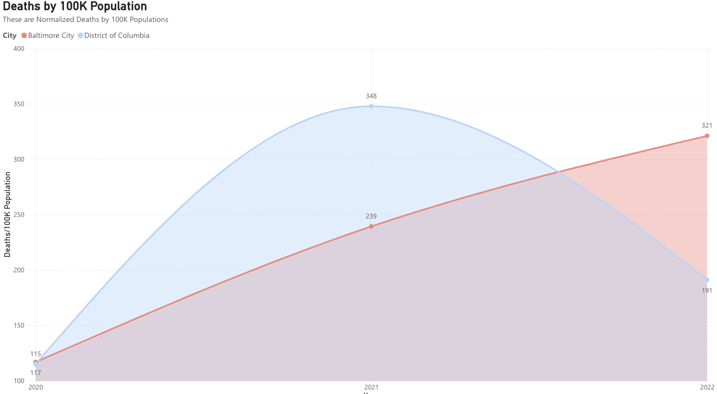
Again, DC has a sharp decline in 2022.

Slide 19


DC-Baltimore Comparison
Washington DC
Baltimore city
689,585 POP
68.34 sq mi
585,708 POP
92.28 sq mil
Population, Census 2020

Slide 20

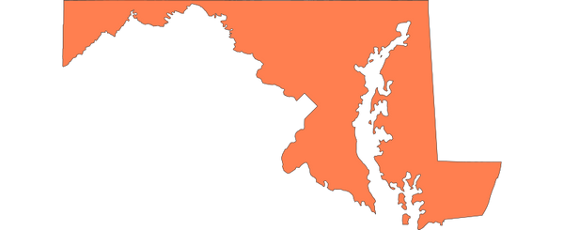
DMV Comparison
55%
26%
27%
DC
Maryland
Virginia
689,585 POP
5,738,299 POP
8,535,519 POP

Slide 21
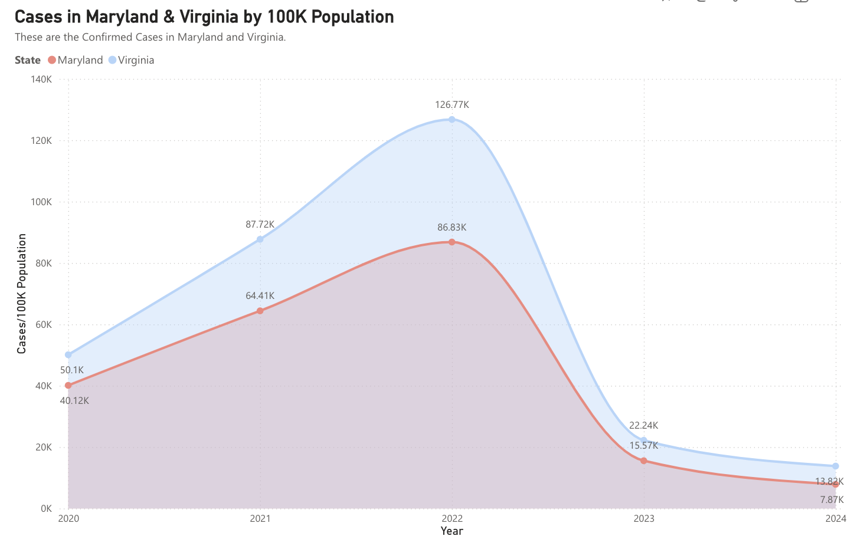
2022 has is the highest number of confirmed cases, followed by a drop in 2023.

Slide 22
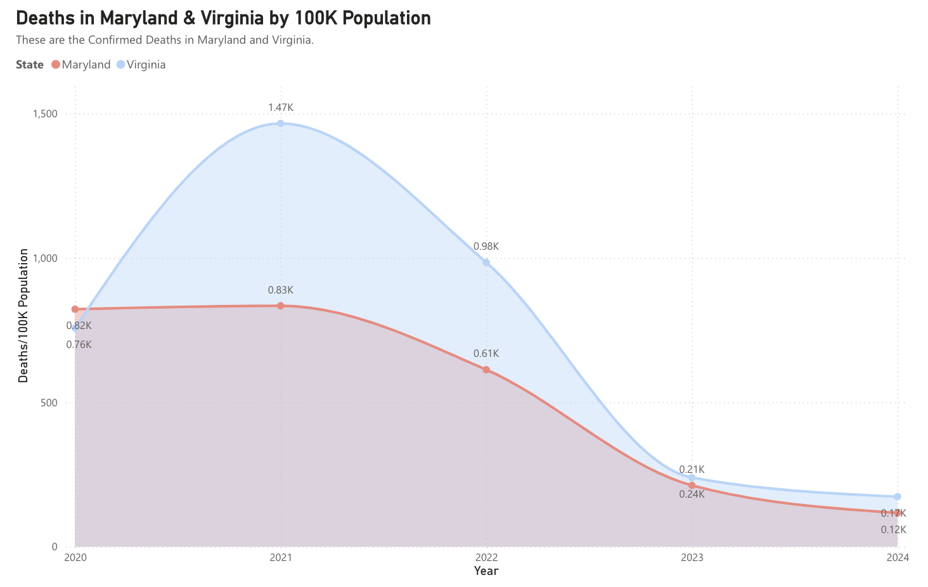
On the Contrary, 2021 has seen the highest deaths, followed by a smooth decline.

Slide 23

Hypothesis 2

Slide 24
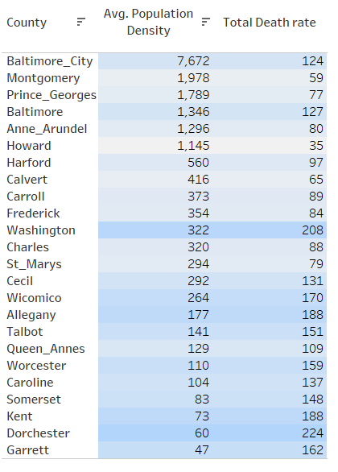
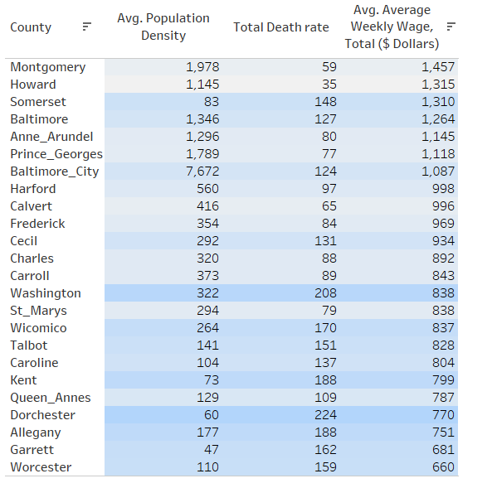
H2
Denser Counties, Higher Death Rates
Counter intuitive right ?
Now it makes more sense

Slide 25
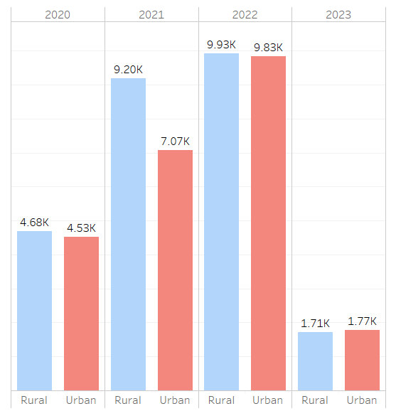
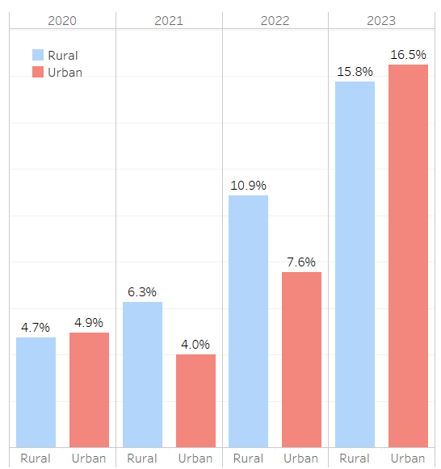
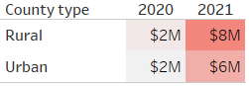
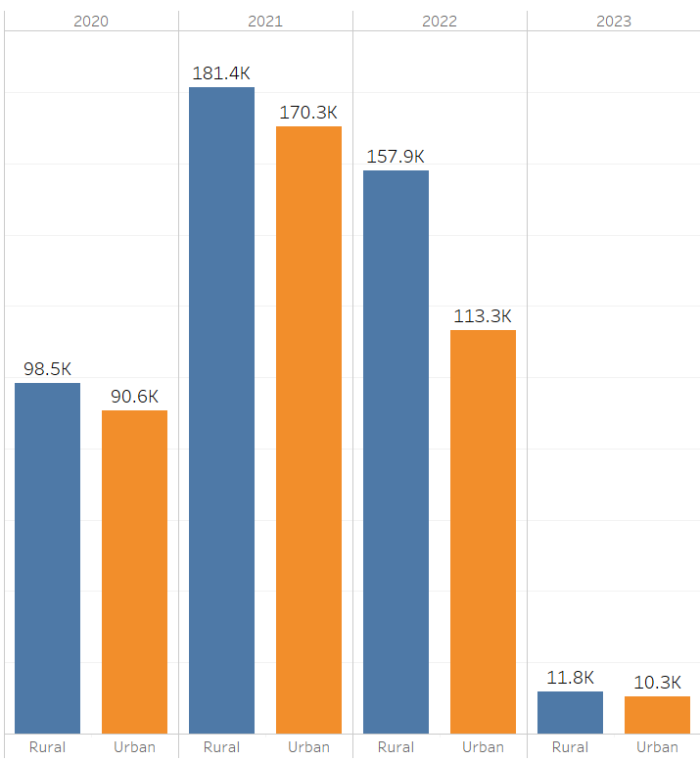
Reported Covid cases per 100K
Positivity Rate
Reported cases higher in Rural areas
Positivity Rates higher in Rural areas
Funds Provided
Rural areas received increased funding on a per 100K population basis.
Testing Volume per 100K
Testing Volume per 100K higher in rural areas

Slide 26
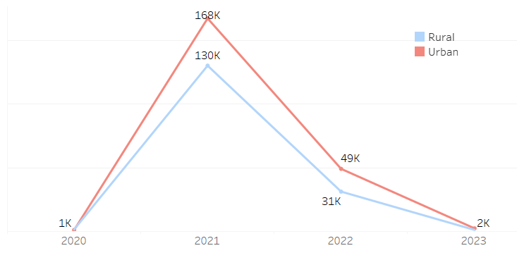
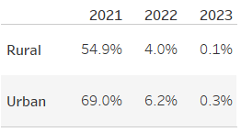
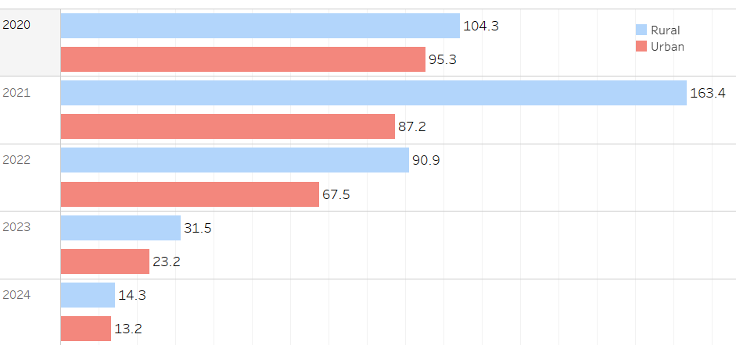
Trends
Vaccination rates are Lower in Rural Areas
Vaccination hesitancy in Rural counties
Death rates per 100K lower in Lower in Rural Areas

Slide 27
Revisiting our Hypothesis
Healthcare Infrastructure: Counties with strong healthcare systems showed resilience, proving that solid infrastructure is key to survival.
Funding Allocation: Smart funding COULD lead to smart outcomes—counties prioritizing COVID-19 mitigation thrived.
Population Density & Economic Disparities: Densely populated, economically challenged counties faced steep hurdles, but their resilience turned survival into success.
In a nutshell, counties with stronger healthcare systems and more resources
fared better in the pandemic,
while those lacking infrastructure struggled.
Turns out, money can’t buy happiness, but it can buy better health outcomes!

Slide 28

Words of Wisdom
"It is health that is real wealth and not pieces of gold and silver."
— Mahatma Gandhi

